Slide 1
Project Presentation
Speaker Detection using Multiple Kinects

Slide 2
Objective
To create a software for speaker detection using multiple Microsoft Kinect sensors, and to display the face of the current speaker.

Slide 3
Description
Multiple Microsoft Kinect sensors are positioned centrally, pointed in different outwards directions to cover a wide field of vision.
When multiple speakers seated around this arrangement are speaking, the software can detect the speaker having maximum sound intensity by using the microphone array of the Microsoft Kinect, and also detect his lip movement using the Depth, Color and Skeletal stream based tracking to verify that he is the current speaker.
Finally the speaker’s face is to be displayed on the screen.

Slide 4
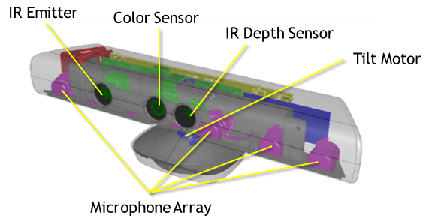
The device : Microsoft Kinect sensor

Slide 5
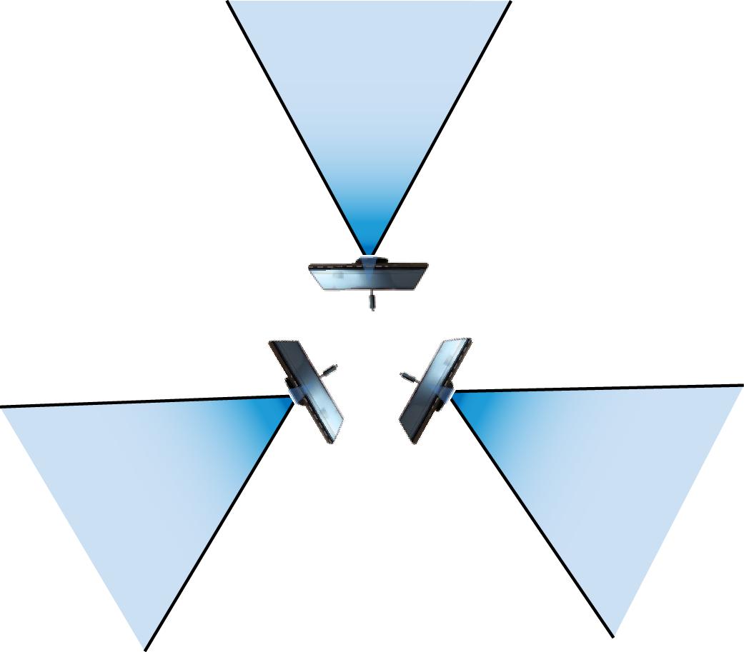
Indicative Setup diagram
The software can be used to cover a wide field of vision by placing multiple Kinect sensors centrally, pointing outwards. We plan to use 3 devices each in directions 120⁰ apart. Each Kinect sensor has a 57° wide horizontal field of view. The speakers are generally assumed to be sitting around the sensors. More sensors can be added as required.

Slide 6
Implementation
Audio Source angle changes are detected and the intensity level has to be above a fixed background noise intensity level, to ensure that random background noise does not interfere.
The device detecting maximum audio intensity for an extended number of frames (3) is fixed to be the maxIntensity device and the colorStream for the same is displayed on screen
All devices continue to detect audio changes, and the display switched to another camera’s stream once that device is established to be the maxIntensity device.

Slide 7
Implementation
For face tracking and lip movement, we are using the Kinect Toolkit which provides specific attributes for the detected faces using depth, color and skeletal stream data.
The ‘facetrackers’ array is a list of FaceTracker objects. Its declared size is equal to MaxKinect value, and each detected Kinect initialises its own facetracker object supplying it with its own multiple stream input data.
On successful run, the tracker object provides ‘Animated unit coefficients’ of which we using the values for JawLower unit.

Slide 8
Implementation
We are using these values to find the speaking motion of a mouth. This part did not execute as planned within the time constraints, so we have disabled all the related face tracking code by commenting them.
The commented final version falls back to the detection of speakers using speech sound intensity levels for camera switching.

Slide 9
Conclusion
This software is capable of detecting the current speaker accurately. It has been tested on an arrangement of two sensors, but can be scaled up to a larger number.
Checks have been included to ensure quick and lag-free switching between the cameras, and to filter out background disturbances causing possibly erroneous detection
It can be used to detect and display the current speaker using sound intensity and location and can be applied in scenarios such as conferencing and meetings.

